Slide 1


ARM TrustZone Password Manager
THARUN KUMAR JAYAPRAKASH(TJ2557)
HUGO MATEOUSK(HM2953)
ESTIMATED TOTAL HOURS:

Slide 2



Plans (Past Week)
Initial plan: Utilize Trusty from AOSP for password manager application development
Setup Trusty environment and explore development possibilities
Expected progress: Begin development of password manager application on Trusty

Slide 3
What Actually Happened
Encountered limitations with Trusty: Unable to develop application due to platform restrictions
Decision to switch to OP-TEE for development
Setup OP-TEE environment and successfully configured QEMU
Implemented hello world program to establish system functionality

Slide 4
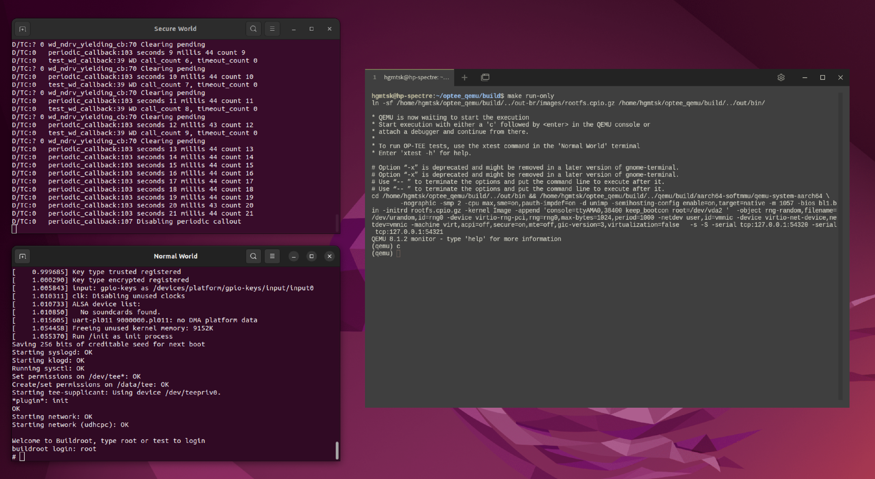
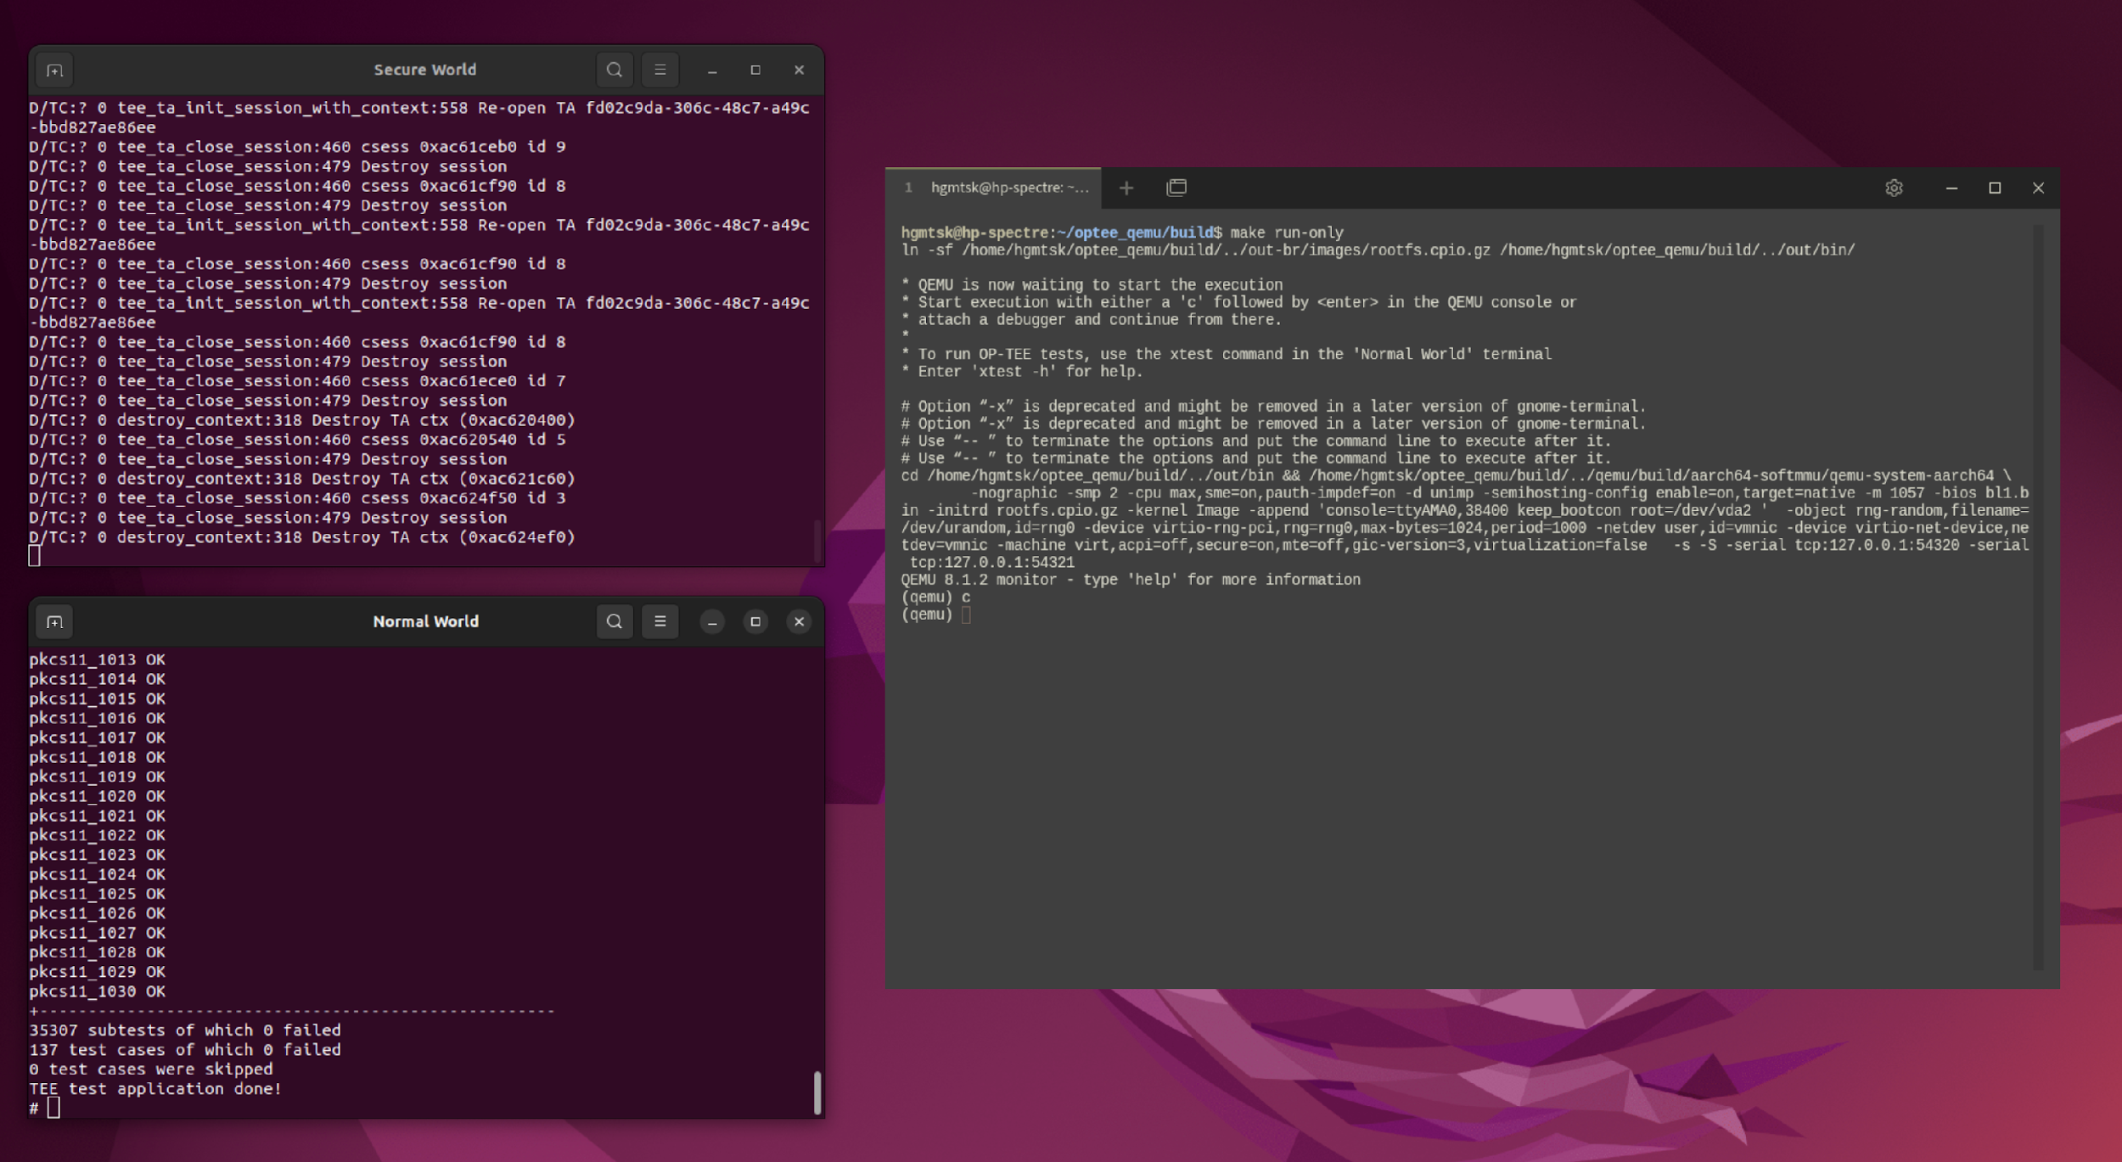
Screenshots

Slide 5

Plans (Next Week)
Define architecture and design considerations for the password manager application within OP-TEE
Begin implementation of core features, such as secure storage and encryption
Evaluate multiple Cryptographic method based on security, efficiency, and compatibility with the OP-TEE environment

Slide 6
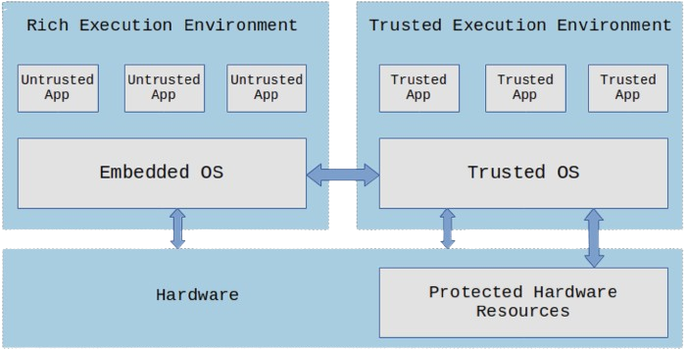
OP-TEE System Architecture
Only trusted applications running on a TEE (Secure World) have complete access to the main processor, peripherals and memory, while hardware isolation protects these from untrusted applications running on the main operating system (Non-Secure World).

Slide 7



Summary/Overall Progress
INITIAL HURDLES FACED WITH TRUSTY AND DECISION TO SWITCH TO OP-TEE
SUCCESSFULLY SETUP OP-TEE ENVIRONMENT AND IMPLEMENTED BASIC FUNCTIONALITY
EXCITEMENT FOR THE NEXT PHASE OF DEVELOPMENT AND ACHIEVING PROJECT GOALS WITH OP-TEE

